Slide 1
Search Algorithms
Any-Path vs. Optimal Path
(Foundation algorithms)
UNINFORMED vs. INFORMED
COMPLETE vs. INCREMENTAL
(Advanced algorithms)

Slide 2
Search Algorithms
Any-Path vs. Optimal Path
(Foundation algorithms)
UNINFORMED vs. INFORMED
DFS with/without Visited List
BFS with/without Visited List
A* with/without Expanded List, Non-Strict Expanded List
IDA*
Introduction to Incremental Search - LPA*

Slide 3
159740
159.741 STATE-SPACE SEARCH
Foundations of Search
Uninformed Search, Informed Search, Any-Path Search, Optimal Search
Source of contents: MIT OpenCourseWare

Slide 4
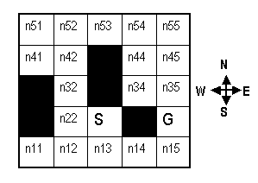
SEARCH
4
Background and Motivation
Consider the maze shown in the figure below. S is the initial state and G is the goal state. Dark squares are blocked cells. All squares, except for the start and goal states, are labelled, with row and column numbers. For example, n54 is the cell in the 5th row, 4th column.
origin
Notes:
First we are going to study a family of Search algorithms. As we will soon learn, search plays a key role in many parts of AI.
Other AI algorithms work in conjunction with search algorithms. It is used largely in games like chess, robot navigation and even mathematical theorem proving.
They provide the conceptual backbone of almost every approach to systematic exploration of alternatives.
=====================================================================================
Search algorithms provide the fundamental concepts to almost every algorithms that systematically explore plans of actions or ways of accomplishing some task.
The possibilities of applications are enormous. We could be solving a problem that involves mathematical proving, assembling parts according to some structure, planning for a travel, and so on and so forth.
=====================================================================================================

Slide 5
SEARCH
4
Background and Motivation
Consider the maze shown in the figure below. S is the initial state and G is the goal state. Dark squares are blocked cells. All squares, except for the start and goal states, are labelled, with row and column numbers. For example, n54 is the cell in the 5th row, 4th column.
4-connected gridworld
Find a path from S to G.
origin
Sequence of exploration of moves: N, E, S, W.
Diagonal moves are not permitted, nor are moves into or across a black square
Notes:
First we are going to study a family of Search algorithms. As we will soon learn, search plays a key role in many parts of AI.
Other AI algorithms work in conjunction with search algorithms. It is used largely in games like chess, robot navigation and even mathematical theorem proving.
They provide the conceptual backbone of almost every approach to systematic exploration of alternatives.
=====================================================================================
Search algorithms provide the fundamental concepts to almost every algorithms that systematically explore plans of actions or ways of accomplishing some task.
The possibilities of applications are enormous. We could be solving a problem that involves mathematical proving, assembling parts according to some structure, planning for a travel, and so on and so forth.
=====================================================================================================

Slide 6
SEARCH
4
Background and Motivation
There are two types of graphs.
Directed Graphs
(one-way streets)
Loops are allowed, node can have multiple parents

Slide 7
SEARCH
4
Background and Motivation
Directed Graphs
(one-way streets)
Undirected Graphs
(two-way streets)
Loops are allowed, node can have multiple parents

Slide 8
SEARCH
4
Background and Motivation
Trees and Graphs
root
Node (vertex)
A
Link (edge)
B
C
Terminal (leaf)
A tree in computer science is an inverted tree, where the root is at the top and the leaves are at the bottom.
Notes:
Now the algorithms that we’re going to study requires some structured representation of the states of the real-world that we are going to explore. The algorithms operate on Trees / Graphs.

Slide 9
SEARCH
4
Background and Motivation
Trees and Graphs
root
Node (vertex)
A
Link (edge)
B
C
B is parent of C
C is a child of B
A is an ancestor of C
C is descendant of A
Terminal (leaf)
Notes:
Now the algorithms that we’re going to study requires some structured representation of the states of the real-world that we are going to explore. The algorithms operate on Trees / Graphs.

Slide 10
SEARCH
4
Background and Motivation
Trees and Graphs
No loops are allowed!
root
Node (vertex)
A
Link (edge)
B
C
A
B
Terminal (leaf)
No local loops are allowed - within a path, there must be no repeating states.
Notes:
Now the algorithms that we’re going to study requires some structured representation of the states of the real-world that we are going to explore. The algorithms operate on Trees / Graphs.

Slide 11
SEARCH
4
Examples of Graphs
Planning actions (graph of possible states of the world)
Here, the nodes denote descriptions of the state of the world
Path = “plan of actions”
B
C
C
Put C on A
A
B
A
Put B on C
A
B
C
A
C
C
Put C on B
A
B
B
Put A on C

Slide 12
SEARCH
4
Problem Solving Paradigm
1
What are the states? (All relevant aspects of the problem)
arrangement of parts (to plan an assembly)
Positions of trucks (to plan package distribution)
City (to plan a trip)
set of facts (to prove geometry theorem)
2
What are the actions? (operators – Deterministic and Discrete)
assemble two parts
move a truck to a new position
fly to a new city
apply a theorem to derive a new fact
3
What is the goal test? (Conditions for success)
all parts in place (to plan an assembly)
all packages delivered (to plan package distribution)
reached final destination city (to plan a trip)
derived goal fact (e.g. to prove geometry theorem)
Notes:
So how do we know if we can solve a problem using Search algorithms?
First, we need to identify 3 main components.

Slide 13
SEARCH
4
Graph Search as Tree Search
We can turn graph search problems (from S to G) into tree search problems by:
Replacing undirected links by 2 directed links
Avoiding loops in path (or keeping track of visited nodes globally)
S
C
A
B
A
D
G
S
B
Convention: arrange the nodes alphabetically, from left to right.

Slide 14
SEARCH
4
Graph Search as Tree Search
We can turn graph search problems (from S to G) into tree search problems by:
Replacing undirected links by 2 directed links
Avoiding loops in path (or keeping track of visited nodes globally)
S
C
A
B
A
D
G
C
D
D
G
S
B

Slide 15
SEARCH
4
Graph Search as Tree Search
We can turn graph search problems (from S to G) into tree search problems by:
Replacing undirected links by 2 directed links
Avoiding loops in path (or keeping track of visited nodes globally)
S
C
A
B
A
D
G
C
D
D
G
S
B
C
G
C
G
Note that nodes may still get duplicated.

Slide 16
3
159.302 STATE-SPACE SEARCH
Any-Path Search
Depth-First Search, Breadth-First Search , Best-First Search

Slide 17
SEARCH
3
Simple Search Algorithm
Let S be the start state.
A Search Node is a path from some state X to the start state
e.g. (G B A S)
Search Node ≡ path
We shall write a path in reverse order, so that we can easily identify the state of the path (where it currently ends).
S
A
B
The state of a search node is the most recent state of the path
e.g. State(G B A S) = G
G

Slide 18
SEARCH
3
Simple Search Algorithm
Let S be the start state.
A Search Node is a path from some state X to the start state
e.g. (X B A S)
Search Node ≡ path
We shall write a path in reverse order, so that we can easily identify the state of the path (where it currently ends).
S
A
B
The state of a search node is the most recent state of the path
e.g. State(X B A S) = X
X

Slide 19
SEARCH
3
Simple Search Algorithm
Let S be the start state.
A Search Node is a path from some state X to the start state
e.g. (X B A S)
The state of a search node is the most recent state of the path
e.g. X
Let Q be a list of search nodes
e.g.
Q
(X B A S) (C B A S) …
Depending on the search algorithm, the Q may be implemented as a stack, queue, priority queue, etc.

Slide 20
SEARCH
4
Simple Search Algorithm
A Search Node is a path from some state X to the start state
e.g. (X B A S)
Guarantees that each state is reached only once.
The state of a search node is the most recent state of the path
e.g. X
1. Initialise Q with search node (S) as only entry; set Visited = (S).
Let Q be a list of search nodes
e.g. (X B A S) (C B A S) …)
Let S be the start state.

Slide 21
SEARCH
4
Simple Search Algorithm
A Search Node is a path from some state X to the start state
e.g. (X B A S)
Guarantees that each state is reached only once.
The state of a search node is the most recent state of the path
e.g. X
1. Initialise Q with search node (S) as only entry; set Visited = (S).
Let Q be a list of search nodes
e.g. (X B A S) (C B A S) …)
2. If Q is empty, fail. Else, pick some search node N from Q.
Let S be the start state.

Slide 22
SEARCH
4
Simple Search Algorithm
A Search Node is a path from some state X to the start state
e.g. (X B A S)
Guarantees that each state is reached only once.
The state of a search node is the most recent state of the path
e.g. X
1. Initialise Q with search node (S) as only entry; set Visited = (S).
Let Q be a list of search nodes
e.g. (X B A S) (C B A S) …)
2. If Q is empty, fail. Else, pick some search node N from Q.
Let S be the start state.
3. If state(N) is a goal, return N (we’ve reached the goal).
4. (Otherwise) Remove N from Q.

Slide 23
SEARCH
4
Simple Search Algorithm
A Search Node is a path from some state X to the start state
e.g. (X B A S)
Guarantees that each state is reached only once.
The state of a search node is the most recent state of the path
e.g. X
1. Initialise Q with search node (S) as only entry; set Visited = (S).
Let Q be a list of search nodes
e.g. (X B A S) (C B A S) …)
2. If Q is empty, fail. Else, pick some search node N from Q.
Let S be the start state.
3. If state (N) is a goal, return N (we’ve reached the goal).
4. (Otherwise) Remove N from Q.
5. Find all the descendants of state (N) not in Visited and create all the one-step extensions of N to each descendant.

Slide 24
SEARCH
4
Simple Search Algorithm
A Search Node is a path from some state X to the start state
e.g. (X B A S)
Guarantees that each state is reached only once.
The state of a search node is the most recent state of the path
e.g. X
1. Initialise Q with search node (S) as only entry; set Visited = (S).
Let Q be a list of search nodes
e.g. (X B A S) (C B A S) …)
2. If Q is empty, fail. Else, pick some search node N from Q.
Let S be the start state.
3. If state (N) is a goal, return N (we’ve reached the goal).
4. (Otherwise) Remove N from Q.
5. Find all the descendants of state (N) not in Visited and create all the one-step extensions of N to each descendant.
6. Add the extended paths to Q; add children of state (N) to Visited.

Slide 25
SEARCH
4
Simple Search Algorithm
A Search Node is a path from some state X to the start state
e.g. (X B A S)
Guarantees that each state is reached only once.
The state of a search node is the most recent state of the path
e.g. X
1. Initialise Q with search node (S) as only entry; set Visited = (S).
Let Q be a list of search nodes
e.g. (X B A S) (C B A S) …)
2. If Q is empty, fail. Else, pick some search node N from Q.
Let S be the start state.
3. If state (N) is a goal, return N (we’ve reached the goal).
4. (Otherwise) Remove N from Q.
5. Find all the descendants of state (N) not in Visited and create all the one-step extensions of N to each descendant.
6. Add the extended paths to Q; add children of state (N) to Visited.
7. Go to Step 2.

Slide 26
SEARCH
4
Simple Search Algorithm
A Search Node is a path from some state X to the start state
e.g. (X B A S)
Guarantees that each state is reached only once.
The state of a search node is the most recent state of the path
e.g. X
1. Initialise Q with search node (S) as only entry; set Visited = (S).
Let Q be a list of search nodes
e.g. (X B A S) (C B A S) …)
2. If Q is empty, fail. Else, pick some search node N from Q.
Let S be the start state.
3. If state (N) is a goal, return N (we’ve reached the goal).
4. (Otherwise) Remove N from Q.
5. Find all the descendants of state (N) not in Visited and create all the one-step extensions of N to each descendant.
Critical Decisions:
Step 2: picking N from Q.
Step 6: adding extensions of N to Q.
6. Add the extended paths to Q; add children of state (N) to Visited.
7. Go to Step 2.

Slide 27
SEARCH
4
Implementing the Search Strategies
Depth-First
1. Pick first element of Q.
2. Add path extensions to front of Q.

Slide 28
SEARCH
4
Implementing the Search Strategies
Depth-First
1. Pick first element of Q.
2. Add path extensions to front of Q.
Breadth-First
1. Pick first element of Q.
2. Add path extensions to end of Q.

Slide 29
Hand-simulation
Let’s look at some simulation
(hand-computations) of the algorithms first before we fully characterize them.

Slide 30
SEARCH
4
Depth-First with Visited List
C
A
D
G
Given the following graph, find a path from S to G using Depth-First Search with the Visited List.
S
B

Slide 31
SEARCH
4
Depth-First with Visited List
Graph
C
Given the following graph, find a path from S to G using Depth-First Search with the Visited List.
A
D
G
S
B
Search tree equivalent
S
A
B
C
D
D
G
C
G
C
G

Slide 32
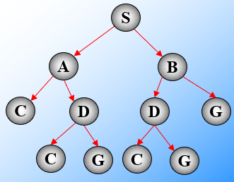
SEARCH
4
Depth-First with Visited List
Step | Dequeued | Q | Visited
0 |  | (S) | S
1
2
3
4
5
Path: ?
Path length: ?
Max Q length: ?
Number of state expansions: ?
Pick first element of Q; Add path extensions to front of Q.
In DFS – nodes are pulled off the Q and inserted into the Q using a stack.

Slide 33
SEARCH
4
Depth-First with Visited List
Step | Dequeued | Q | Visited
0 |  | (S) | S
1 | (S) | (AS)(BS) | S,A,B
2
3
4
5
Search Tree
Path: ?
Path length: ?
Max Q length: ?
Number of state expansions: ?
Pick first element of Q; Add path extensions to front of Q.
In DFS – nodes are pulled off the Q and inserted into the Q using a stack.

Slide 34
SEARCH
4
Depth-First with Visited List
Step | Dequeued | Q | Visited
0 |  | (S) | S
1 | (S) | (AS)(BS) | S,A,B
2 | (AS) | (CAS)(DAS)(BS) | S,A,B,C,D
3
4
5
Search Tree
Path: ?
Path length: ?
Max Q length: ?
Number of state expansions: ?
Pick first element of Q; Add path extensions to front of Q.
In DFS – nodes are pulled off the Q and inserted into the Q using a stack.

Slide 35
SEARCH
4
Depth-First with Visited List
Step | Dequeued | Q | Visited
0 |  | (S) | S
1 | (S) | (AS)(BS) | S,A,B
2 | (AS) | (CAS)(DAS)(BS) | S,A,B,C,D
3 | (CAS) | (DAS)(BS) | S,A,B,C,D
4
5
Search Tree
Path: ?
Path length: ?
Max Q length: ?
Number of state expansions: ?
Pick first element of Q; Add path extensions to front of Q.
In DFS – nodes are pulled off the Q and inserted into the Q using a stack.

Slide 36
SEARCH
4
Depth-First with Visited List
Step | Dequeued | Q | Visited
0 |  | (S) | S
1 | (S) | (AS)(BS) | S,A,B
2 | (AS) | (CAS)(DAS)(BS) | S,A,B,C,D
3 | (CAS) | (DAS)(BS) | S,A,B,C,D
4 | (DAS) | (GDAS)(BS) | S,A,B,C,D,G
5
Search Tree
Path: ?
Path length: ?
Max Q length: ?
Number of state expansions: ?
Pick first element of Q; Add path extensions to front of Q.
In DFS – nodes are pulled off the Q and inserted into the Q using a stack.

Slide 37
SEARCH
4
Depth-First with Visited List
Step | Dequeued | Q | Visited
0 |  | (S) | S
1 | (S) | (AS)(BS) | S,A,B
2 | (AS) | (CAS)(DAS)(BS) | S,A,B,C,D
3 | (CAS) | (DAS)(BS) | S,A,B,C,D
4 | (DAS) | (GDAS)(BS) | S,A,B,C,D,G
5 | (GDAS) | (BS)
Search Tree
Path: S-A-D-G
Path length: 3
Max Q length: 3
Number of state expansions: 5
Sequence of State Expansions: S-A-C-D-G
Pick first element of Q; Add path extensions to front of Q.
In DFS – nodes are pulled off the Q and inserted into the Q using a stack.

Slide 38
SEARCH
4
Depth-First with Visited List
Step | Dequeued | Q | Visited
0 |  | (S) | S
1 | (S) | (AS)(BS) | S,A,B
2 | (AS) | (CAS)(DAS)(BS) | S,A,B,C,D
3 | (CAS) | (DAS)(BS) | S,A,B,C,D
4 | (DAS) | (GDAS)(BS) | S,A,B,C,D,G
5 | (GDAS) | (BS)
Search Tree
1
S
2
A
B
3
4
C
D
D
G
5
C
G
C
G
Path: S-A-D-G
Path length: 3
Max Q length: 3
Number of state expansions: 5
Sequence of State Expansions: S-A-C-D-G
Pick first element of Q; Add path extensions to front of Q.
In DFS – nodes are pulled off the Q and inserted into the Q using a stack.

Slide 39
SEARCH
4
Depth-First without Visited List
Step | Q
1 | (S)
2 | (AS)(BS)
3 | (CAS)(DAS)(BS)
4 | (DAS)(BS)
5 | (CDAS)(GDAS)(BS)
6 | (GDAS)(BS)
C
A
D
G
S
B
Path: S-A-D-G
Path length: 3
Max Q length: 3
Number of state expansions: 6
Sequence of State Expansions: S-A-C-D-C-G
Pick first element of Q; Add path extensions to front of Q.
Do NOT extend a path to a state if the resulting path would have a loop.
If we have visited a state along a particular path, we do not re-visit that state again in any extensions of the path

Slide 40
SEARCH
4
Breadth-First with Visited List
Step | Dequeued | Q | Visited
0 |  | (S) | S
1
2
3
4
5
6
Path: ?
Path length: ?
Max Q length: ?
Number of state expansions: ?
Pick first element of Q; Add path extensions to END of Q.

Slide 41
SEARCH
4
Breadth-First with Visited List
Step | Dequeued | Q | Visited
0 |  | (S) | S
1 | (S) | (AS)(BS) | S,A,B
2
3
4
5
6
Path: ?
Path length: ?
Max Q length: ?
Number of state expansions: ?
Pick first element of Q; Add path extensions to END of Q.

Slide 42
SEARCH
4
Breadth-First with Visited List
Step | Dequeued | Q | Visited
0 |  | (S) | S
1 | (S) | (AS)(BS) | S,A,B
2 | (AS) | (BS)(CAS)(DAS) | S,A,B,C,D
3
4
5
6
Path: ?
Path length: ?
Max Q length: ?
Number of state expansions: ?
Pick first element of Q; Add path extensions to END of Q.

Slide 43
SEARCH
4
Breadth-First with Visited List
Step | Dequeued | Q | Visited
0 |  | (S) | S
1 | (S) | (AS)(BS) | S,A,B
2 | (AS) | (BS)(CAS)(DAS) | S,A,B,C,D
3 | (BS) | (CAS)(DAS)(GBS) | S,A,B,C,D,G
4
5
6
Path: ?
Path length: ?
Max Q length: ?
Number of state expansions: ?
Pick first element of Q; Add path extensions to END of Q.

Slide 44
SEARCH
4
Breadth-First with Visited List
Step | Dequeued | Q | Visited
0 |  | (S) | S
1 | (S) | (AS)(BS) | S,A,B
2 | (AS) | (BS)(CAS)(DAS) | S,A,B,C,D
3 | (BS) | (CAS)(DAS)(GBS) | S,A,B,C,D,G
4 | (CAS) | (DAS)(GBS) | S,A,B,C,D,G
5
6
Path: ?
Path length: ?
Max Q length: ?
Number of state expansions: ?
Pick first element of Q; Add path extensions to END of Q.

Slide 45
SEARCH
4
Breadth-First with Visited List
Step | Dequeued | Q | Visited
0 |  | (S) | S
1 | (S) | (AS)(BS) | S,A,B
2 | (AS) | (BS)(CAS)(DAS) | S,A,B,C,D
3 | (BS) | (CAS)(DAS)(GBS) | S,A,B,C,D,G
4 | (CAS) | (DAS)(GBS) | S,A,B,C,D,G
5 | (DAS) | (GBS) | S,A,B,C,D,G
6
Path: ?
Path length: ?
Max Q length: ?
Number of state expansions: ?
Pick first element of Q; Add path extensions to END of Q.

Slide 46
SEARCH
4
Breadth-First with Visited List
Step | Dequeued | Q | Visited
0 |  | (S) | S
1 | (S) | (AS)(BS) | S,A,B
2 | (AS) | (BS)(CAS)(DAS) | S,A,B,C,D
3 | (BS) | (CAS)(DAS)(GBS) | S,A,B,C,D,G
4 | (CAS) | (DAS)(GBS) | S,A,B,C,D,G
5 | (DAS) | (GBS) | S,A,B,C,D,G
6 | (GBS) |  | S,A,B,C,D,G
Path: ?
Path length: ?
Max Q length: ?
Number of state expansions: ?
Pick first element of Q; Add path extensions to END of Q.

Slide 47
SEARCH
4
Breadth-First with Visited List
Step | Dequeued | Q | Visited
0 |  | (S) | S
1 | (S) | (AS)(BS) | S,A,B
2 | (AS) | (BS)(CAS)(DAS) | S,A,B,C,D
3 | (BS) | (CAS)(DAS)(GBS) | S,A,B,C,D,G
4 | (CAS) | (DAS)(GBS) | S,A,B,C,D,G
5 | (DAS) | (GBS) | S,A,B,C,D,G
6 | (GBS) |  | S,A,B,C,D,G
Path: S-B-G
Path length: 2
Max Q length: 3
Number of state expansions: 6
Sequence of State Expansions: S-A-B-C-D-G
Pick first element of Q; Add path extensions to END of Q.

Slide 48
SEARCH
4
Breadth-First with Visited List
Step | Dequeued | Q | Visited
0 |  | (S) | S
1 | (S) | (AS)(BS) | S,A,B
2 | (AS) | (BS)(CAS)(DAS) | S,A,B,C,D
3 | (BS) | (CAS)(DAS)(GBS) | S,A,B,C,D,G
4 | (CAS) | (DAS)(GBS) | S,A,B,C,D,G
5 | (DAS) | (GBS) | S,A,B,C,D,G
6 | (GBS) |  | S,A,B,C,D,G
1
S
2
3
A
B
4
5
6
C
D
D
G
C
G
C
G
Path: S-B-G
Path length: 2
Max Q length: 3
Number of state expansions: 6
Sequence of State Expansions: S-A-B-C-D-G
Pick first element of Q; Add path extensions to END of Q.

Slide 49
SEARCH
4
Breadth-First without Visited List
Step | Q
1 | (S)
2 | (AS)(BS)
3 | (BS)(CAS)(DAS)
4 | (CAS)(DAS)(DBS)(GBS)
5 | (DAS)(DBS)(GBS)
6 | (DBS)(GBS)(CDAS)(GDAS)
7 | (GBS)(CDAS)(GDAS)(CDBS)(GDBS)
C
A
D
G
S
B
Path: S-B-G
Path length: 2
Max Q length: 5
Number of state expansions: 7
Sequence of State Expansions: S-A-B-C-D-D-G
Pick first element of Q; Add path extensions to END of Q.

Slide 50
Worst case scenarios
Worst case running time
Worst case space

Slide 51
SEARCH
4
Worst Case Running Time for all Searches
Max Time is proportional to the Max. number of Nodes visited.
The number of states in the search space may be exponential in some “depth” parameter,
e.g. number of actions in a plan, number of moves in a game.
d=0
b=2
d=1
d=2
d=3
Tree represents the search space
d is depth
b is branching factor

Slide 52
SEARCH
4
Worst Case Running Time for all Searches
In the worst case, all the searches, with or without visited list may have to visit each state at least once.
Max Time is proportional to the Max. number of Nodes visited.
b=2
d=0
d=1
So, all searches will have worst case running times that are at least proportional to the total number of states and therefore exponential in the “depth” parameter.
d=2
d=3
d is depth
b is branching factor
Number of States in the tree = b^{d} < (b^{d+1} – 1)/(b-1) < b^{d+1}

Slide 53
SEARCH
4
Worst Case Space for Depth-First Search
Dominant Factor: Max Q Size = Max (#visited – #expanded).
b=2
expanded
d=0
visited
d=1
d=2
d=3
Depth-first Search: maximum Q size (always less than bd): (b-1)d ≈ bd
The Q holds the number of unexpanded “siblings” of the nodes along the path that we are currently considering.
The space requirements are linear in d.

Slide 54
SEARCH
4
Exercise: Worst Case Space for Depth-First Search
Dominant Factor: Max Q Size = Max (#visited – #expanded).
Depth-First Search
S
Problem Illustration:
A
B
C
D
E
F
H
I
J
K
L
M
N
O
G
P
Q
R
T
U
V
W
X
Y
Z₁
Z₂
Z₃
Z₄
Z₅
Z₆
In search for a path to G, what is the max Q length incurred, and when does it happen (at which depth)?
Notes:
After expanding node H, at depth=3
maxQlength=5
After expanding node H, at depth=3
maxQlength=5

Slide 55
SEARCH
4
Exercise: Worst Case Space for Depth-First Search
Dominant Factor: Max Q Size = Max (#visited – #expanded).
Expanded states
1
Visited states
Depth-First Search
S
Problem Illustration:
2
A
B
3
C
D
E
F
4
H
I
J
K
L
M
N
O
5
G
P
Q
R
T
U
V
W
X
Y
Z₁
Z₂
Z₃
Z₄
Z₅
Z₆
In search for a path to G, what is the max Q length incurred, and when does it happen (at which depth)?
Max Q Length = Max(#visited - #expanded) = 9 – 4 = 5
Notes:
After expanding node H, at depth=3
maxQlength=5
After expanding node H, at depth=3
maxQlength=5

Slide 56
SEARCH
4
Worst Case Space (DFS vs. BFS)
expanded
Max Q Size = Max (#visited – #expanded).
visited
b=2
d=0
d=1
*
d=2
d=3
Depth-first maximum Q size: (b-1)d ≈ bd
Breadth-first max. Q size: b^{d}
Notes:
For BFS, the worst case space happens after expanding the right-most node at depth (d-1). At this point, all of the nodes at depth d resides in the Q, and none of them expanded.

Slide 57
SEARCH
4
Exercise: Worst Case Space for Breadth-First Search
Dominant Factor: Max Q Size = Max (#visited – #expanded).
Breadth-First Search
S
Problem Illustration:
A
B
C
D
E
F
G
H
I
J
K
L
M
N
In search for a path to G, what is the max Q length incurred, and when does it happen (at which depth)?
Notes:
maxQLength=8
After expanding (FBS), at depth=2

Slide 58
SEARCH
4
Exercise: Worst Case Space for Breadth-First Search
Dominant Factor: Max Q Size = Max (#visited – #expanded).
Expanded states
1
Visited states
Breadth-First Search
S
Problem Illustration:
2
3
A
B
4
5
6
7
C
D
E
F
8
G
H
I
J
K
L
M
N
Breadth-first max. Q size: b^{d}
In search for a path to G, what is the max Q length incurred, and when does it happen (at which depth)?
Max Q Length = Max(#visited - #expanded) = 15 – 7 = 8
Notes:
maxQLength=8
After expanding (FBS), at depth=2

Slide 59
SEARCH
4
Cost and Performance of Any-Path Methods
Searching a tree with branching factor b and depth d (without using a Visited List)
Search Method | Worst Time | Worst Space | Fewest states? | Guaranteed to find a path?
Depth-First | b^{d+1} | bd | No | Yes*
Breadth-First | b^{d+1} | b^{d} | Yes | Yes
*If there are no indefinitely long paths in the search space
Worst case time is proportional to the number of nodes added to Q.
Worst case space is proportional to maximal length of Q.
Considering that all states are unique

Slide 60
SEARCH
4
Cost and Performance of Any-Path Methods
Searching a tree with branching factor b and depth d (with Visited List)
Search Method | Worst Time | Worst Space | Fewest states? | Guaranteed to find a path?
Depth-First | b^{d+1} | bd b^{d+1} | No | Yes*
Breadth-First | b^{d+1} | b^{d} b^{d+1} | Yes | Yes
*If there are no indefinitely long paths in the search space
Worst case time is proportional to the number of nodes added to Q.
Worst case space is proportional to maximal length of Q and Visited list.

Slide 61
SEARCH
4
States vs. Path
Using the Visited List is a way of spending space to limit the worst case running time.
b=2
d=0
d=1
d=2
d=3
Using a Visited list, the worst-case time performance is limited by the number of states in the search space rather than the number of paths through the nodes in the space (which may be exponentially larger than the number of states).
Using a Visited list helps prevent loops; that is, no path visits a state more than once.
However, using the Visited list for very large spaces may not be appropriate as the space requirements would be prohibitive.

Slide 62
8 Puzzle Problem
Given the start state, find the sequence of moves that will arrange the tiles according to the goal state.
4
2
1
2
1
5
8
3
4
5
3
6
7
6
7
8
Start
Goal
Tiles can be moved up, down, left, or right, provided that the following conditions are met:
There is no other tile blocking the direction of the movement.
Tiles are not moved outside of the boundaries.
Notes:
Have you ever wondered how to write a program that can solve a puzzle problem.
Let us consider the 8-puzzle problem. Many of you are probably familiar with it already. Given a Start state (an arbitrary arrangement of tiles on the board), find the sequence of steps that will arrange the tiles according to the Goal State defined.
You can slide the tile Up, Down, Left or Right, provided that no other tile is blocking the direction of the movement. Of course, you are not allowed to pluck any of the tiles out of the board and then insert it back on your preferred position.
Wouldn’t it be nice to learn an algorithm that can always solve the puzzle problem really quickly?

Slide 63
Search
We can think of a move as moving the blank tile.
Goal State
Start State
1 | 2 | 3
8 |  | 4
7 | 6 | 5
2 | 8 | 3
1 | 6 | 4
7 |  | 5
Left
Up
Right
Down
2 | 8 | 3
1 | 6 | 4
 | 7 | 5
2 | 8 | 3
1 |  | 4
7 | 6 | 5
2 | 8 | 3
1 | 6 | 4
7 | 5
Given the start state, we can examine the different possible moves that can be carried out from that state.

Slide 64
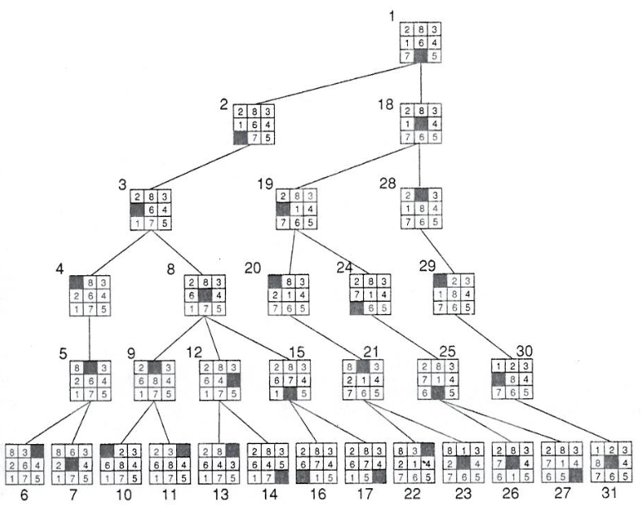
Uninformed Any-Path Search
Algorithm systematically explores a search tree to find the sequence of moves that leads to the Goal state.
2 | 8 | 3
1 | 6 | 4
7 |  | 5
Start State
Up
e.g. Depth-Limited Depth-First Search
Up
Left
Down
Right
1 | 2 | 3
8 |  | 4
7 | 6 | 5
Goal State
Notes:
This algorithm will look for any possible solution to the puzzle problem by traversing the tree systematically. The algorithm dives deep into the tree up to some maximum depth, and then it backtracks if no solution is found along that path. Here we can see that the tree traversal is done from top to bottom, moving left to right. After 31 moves, the algorithm was able to find a solution.

Slide 65
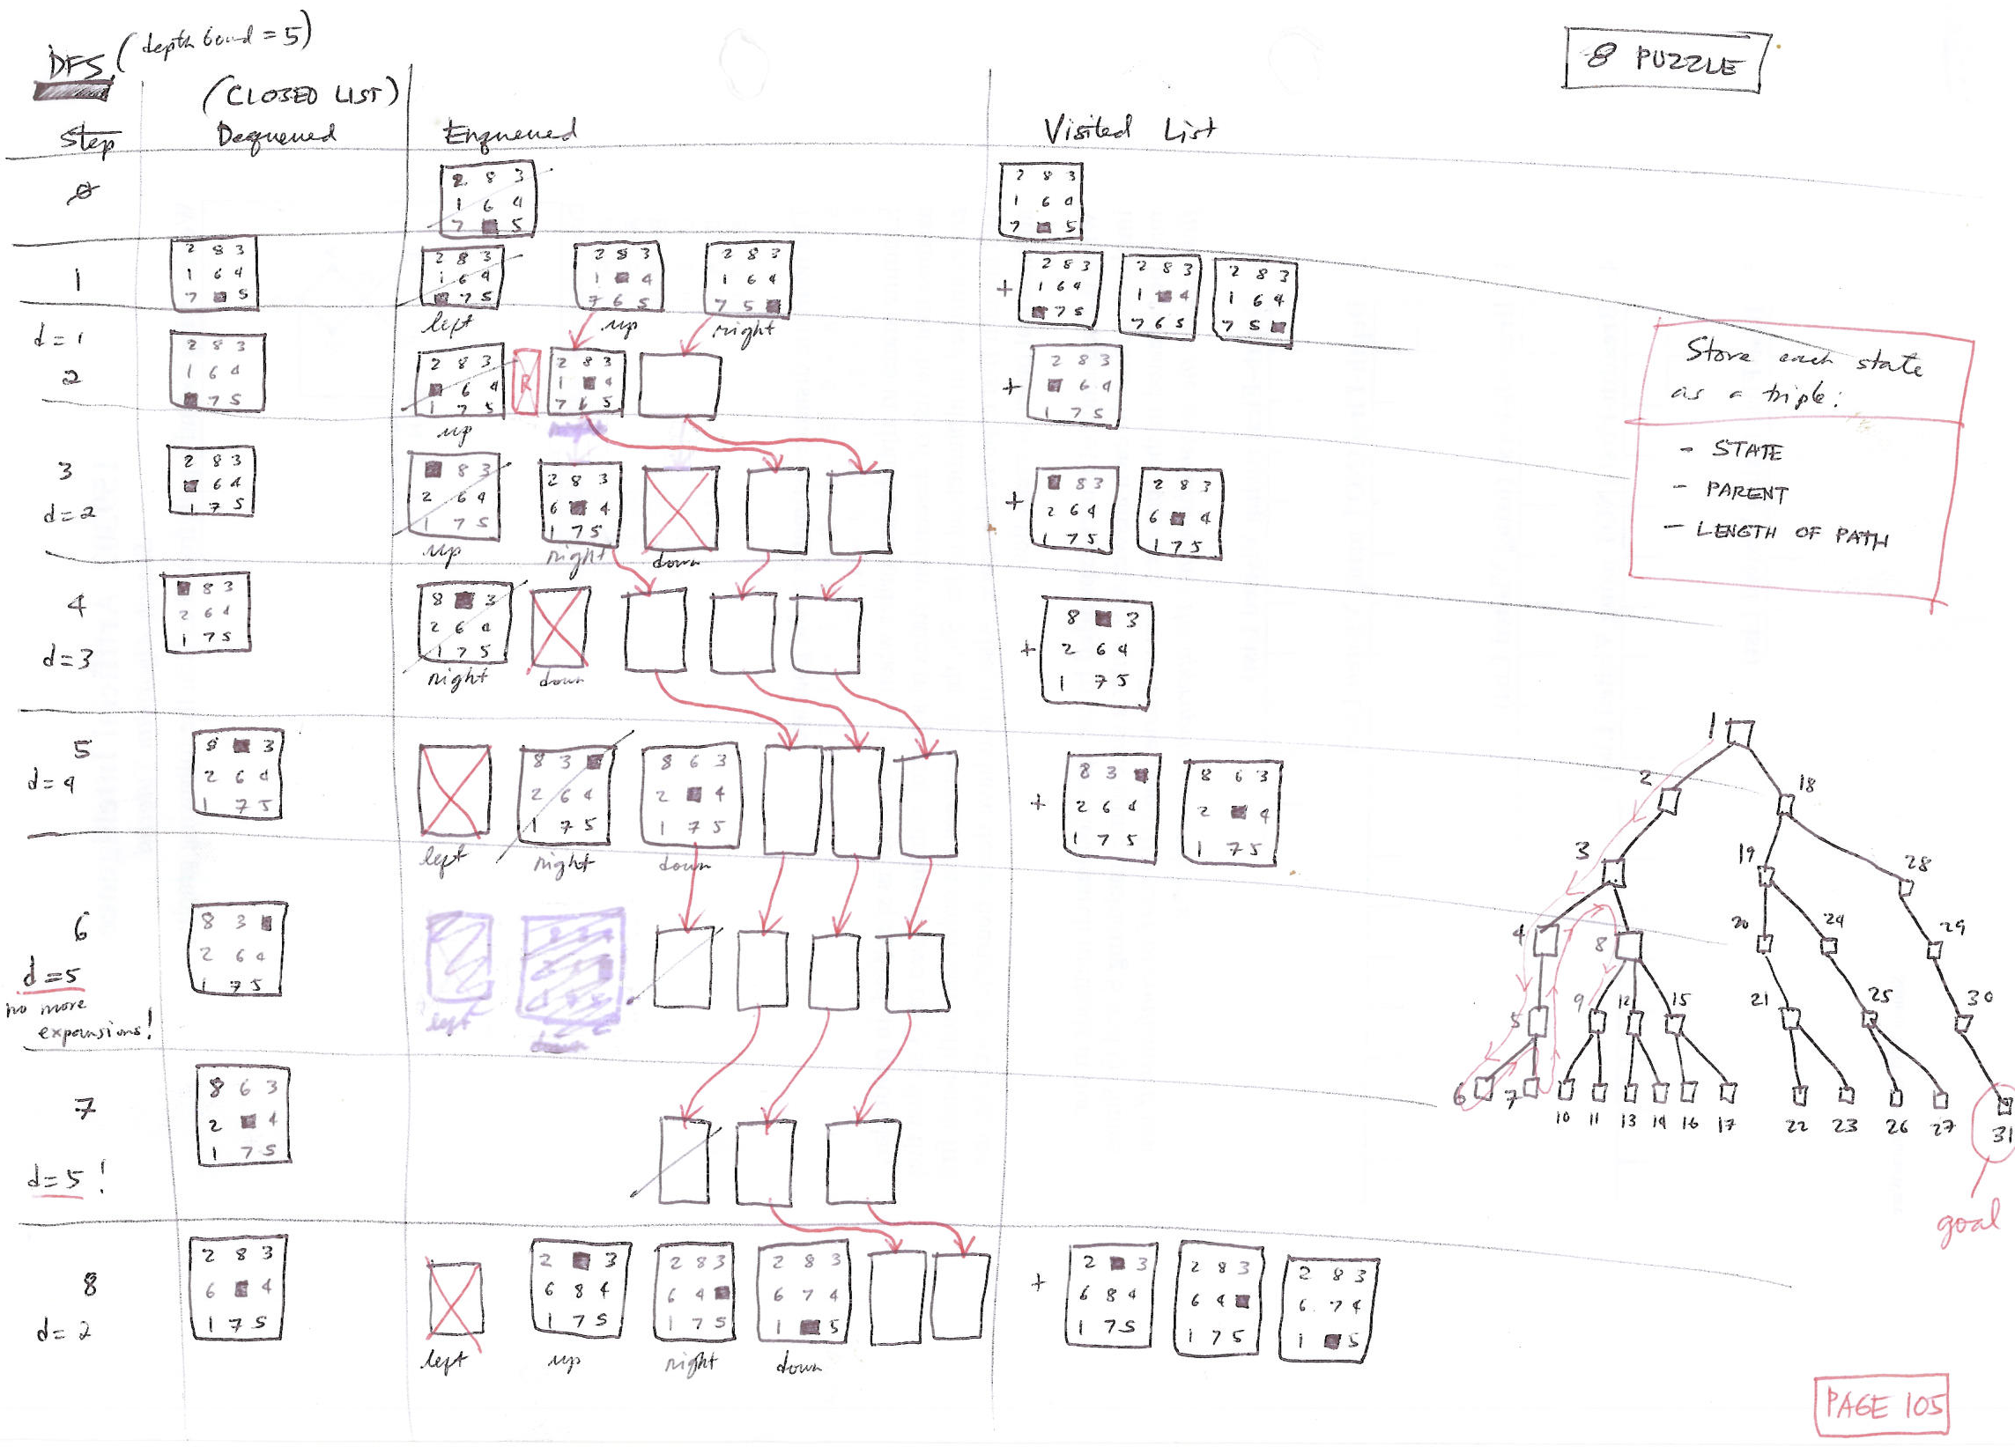
Depth-limited Depth-First Search
Successor generator: Left, Up, Right, Down

Slide 66
5
159.302 STATE-SPACE SEARCH
Optimal Search
Optimal Informed Search: A* Search

Slide 67
SEARCH
3
Simple Search Algorithm
A Search Node is a path from some state X to the start state
e.g. (X B A S)
The state of a search node is the most recent state of the path
e.g. X
1. Initialise Q with search node (S) as only entry; set Visited = (S).
Let Q be a list of search nodes
e.g. (X B A S) (C B A S) …)
2. If Q is empty, fail. Else, pick some search node N from Q.
3. If state (N) is a goal, return N (we’ve reached the goal).
Let S be the start state.
4. (Otherwise) Remove N from Q.
5. Find all the descendants of state (N) not in Visited and create all the one-step extensions of N to each descendant.
6. Add the extended paths to Q; add children of state (N) to Visited.
Do NOT use Visited List for Optimal Searching!
7. Go to Step 2.
Critical Decisions:
Step 2: picking N from Q.
Step 6: adding extensions of N to Q.

Slide 68
SEARCH
3
Classes of Search
Class | Name | Operation
Any Path Uninformed | Depth-First | Systematic exploration of the whole tree until a goal is found
 | Breadth-First
Any Path Informed | Best-First | Uses heuristic measure of goodness of a state (e.g. estimated distance to goal)
Optimal Uninformed | Uniform-Cost | Uses path “length” measure. Finds “shortest” path.
Optimal Informed | A* | Uses path “length” measure and heuristic. Finds “shortest” path.

Slide 69
A* - Optimal & Informed Search
We can introduce a bias to the search by means of a heuristic function h(N), which is an estimate (h) of the distance from a state to the goal.
f= g + h
G
G
100
A
C
S
1
1
S
B
h = Estimate of the goal distance
2
2
B
g = Start distance
Heuristic Values:
A=100, B=88, C=100, S=90, G=0
An estimate that always underestimates the real path length to the goal is called admissible. For example, an estimate of 0 is admissible (but useless). Straight line distance is admissible estimate for path length in Euclidean space.
Use of an admissible estimate guarantees that A* will still find the shortest path.

Slide 70
SEARCH
4
A*
Given the following graph and heuristic values, find a path from S to G using the A* algorithm.
C
2
3
A
D
2
G
2
4
S
1
5
B
5
Heuristic Values:
A=2, B=3, C=1, D=1, S=0, G=0
For our convention in class, add the path extensions to the front of the Queue.
Pick best (by path length + heuristic) element of Q, Add path extensions anywhere in Q.

Slide 71
SEARCH
4
A*
Given the following graph and heuristic values, find a path from S to G using the A* algorithm.
Search Tree
S
2
5
C
A
2
B
3
2
4
1
5
A
D
2
G
2
4
C
D
D
G
S
3
2
3
2
1
5
B
5
C
G
C
G
Heuristic Values:
A=2, B=3, C=1, D=1, S=0, G=0
For our convention in class, add the path extensions to the front of the Queue.
Pick best (by path length + heuristic) element of Q, Add path extensions anywhere in Q.

Slide 72
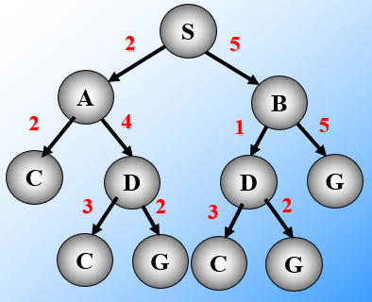
SEARCH
4
A*
Step | Dequeued | Q
0 |  | (0 S)
1 | (0 S) | (4 AS)(8 BS)
2
3
4
5
Heuristic Values:
A=2, B=3, C=1, D=1, S=0, G=0
For our convention in class, add the path extensions to the front of the Queue.
Sequence of State Expansions: S – A – C – D - G
Pick best (by path length + heuristic) element of Q, Add path extensions anywhere in Q.

Slide 73
SEARCH
4
A*
Step | Dequeued | Q
0 |  | (0 S)
1 | (0 S) | (4 AS)(8 BS)
2 | (4 AS) | (5 CAS)(7 DAS)(8 BS)
3
4
5
Heuristic Values:
A=2, B=3, C=1, D=1, S=0, G=0
For our convention in class, add the path extensions to the front of the Queue.
Sequence of State Expansions: S – A – C – D - G
Pick best (by path length + heuristic) element of Q, Add path extensions anywhere in Q.

Slide 74
SEARCH
4
A*
Step | Dequeued | Q
0 |  | (0 S)
1 | (0 S) | (4 AS)(8 BS)
2 | (4 AS) | (5 CAS)(7 DAS)(8 BS)
3 | (5 CAS) | (7 DAS)(8 BS)
4
5
Heuristic Values:
A=2, B=3, C=1, D=1, S=0, G=0
For our convention in class, add the path extensions to the front of the Queue.
Sequence of State Expansions: S – A – C – D - G
Pick best (by path length + heuristic) element of Q, Add path extensions anywhere in Q.

Slide 75
SEARCH
4
A*
Step | Dequeued | Q
0 |  | (0 S)
1 | (0 S) | (4 AS)(8 BS)
2 | (4 AS) | (5 CAS)(7 DAS)(8 BS)
3 | (5 CAS) | (7 DAS)(8 BS)
4 | (7 DAS) | (10 CDAS)(8 GDAS) (8 BS)
5
Heuristic Values:
A=2, B=3, C=1, D=1, S=0, G=0
For our convention in class, add the path extensions to the front of the Queue.
Sequence of State Expansions: S – A – C – D - G
Pick best (by path length + heuristic) element of Q, Add path extensions anywhere in Q.

Slide 76
SEARCH
4
A*
Step | Dequeued | Q
0 |  | (0 S)
1 | (0 S) | (4 AS)(8 BS)
2 | (4 AS) | (5 CAS)(7 DAS)(8 BS)
3 | (5 CAS) | (7 DAS)(8 BS)
4 | (7 DAS) | (10 CDAS)(8 GDAS) (8 BS)
5 | (8 GDAS)
Heuristic Values:
A=2, B=3, C=1, D=1, S=0, G=0
For our convention in class, add the path extensions to the front of the Queue.
Sequence of State Expansions: S – A – C – D - G
Pick best (by path length + heuristic) element of Q, Add path extensions anywhere in Q.

Slide 77
Heuristics
Examples

Slide 78
SEARCH
4
Not all heuristics are admissible
C
Given the link lengths in the figure, is the table of heuristic values an admissible heuristic?
2
3
A
D
2
G
2
4
S
1
5
B
5
Heuristic values:
A=2, B=3, C=1, D=4, S=10, G=0

Slide 79
SEARCH
4
Not all heuristics are admissible
C
Given the link lengths in the figure, is the table of heuristic values an admissible heuristic?
2
3
A
D
2
G
2
4
S
1
5
B
5
No!
A is ok
B is ok
C is ok
D is too big, needs to be <= 2
S is too big, can always use 0 for start
Heuristic values:
A=2, B=3, C=1, D=4, S=10, G=0

Slide 80
SEARCH
4
Admissible Heuristics
8 Puzzle: Move tiles to reach goal. Think of a move as moving an “empty” tile.
6 | 2 | 8
 | 3 | 5
4 | 7 | 1
1 | 2 | 3
8 |  | 4
7 | 6 | 5
S
G
Alternative underestimates of “distance” (number of moves) to goal:
Number of misplaced tiles (7 in the example above).

Slide 81
SEARCH
4
Admissible Heuristics
8 Puzzle: Move tiles to reach goal. Think of a move as moving an “empty” tile.
Number of misplaced tiles
1 |  | 3
8 | 2 | 4
7 | 6 | 5
1 | 2 | 3
8 |  | 4
7 | 6 | 5
S
G
Are we supposed to include the blank tile in the counting of misplaced tiles?
What will be the consequence if we include it? Examine the case above.
Number of misplaced tiles:

Slide 82
SEARCH
4
Admissible Heuristics
8 Puzzle: Move tiles to reach goal. Think of a move as moving an “empty” tile.
Number of misplaced tiles
1 |  | 3
8 | 2 | 4
7 | 6 | 5
1 | 2 | 3
8 |  | 4
7 | 6 | 5
S
G
Are we supposed to include the blank tile in the counting of misplaced tiles? No.
What will be the consequence if we include it? the heuristic will not be admissible.
Number of misplaced tiles: 1

Slide 83
SEARCH
4
Admissible Heuristics
8 Puzzle: Move tiles to reach goal. Think of a move as moving an “empty” tile.
6 | 2 | 8
 | 3 | 5
4 | 7 | 1
1 | 2 | 3
8 |  | 4
7 | 6 | 5
S
G
Alternative underestimates of “distance” (number of moves) to goal:
Number of misplaced tiles (7 in the example above).
Sum of Manhattan Distance of tile to its goal location (17 in example above).
Manhattan Distance between (x₁, y₁) and (x₂, y₂) is │x₁ – x₂│ +│y₁ – y₂│.
Each move can only decrease the distance of exactly one tile.
The second of these is much better at predicting actual number of moves.

Slide 84
SEARCH
4
Admissible Heuristics
0
1
2
0
1
2
x
x
0
6 | 2 | 8
 | 3 | 5
4 | 7 | 1
0
1 | 2 | 3
8 |  | 4
7 | 6 | 5
1
1
2
2
y
S
y
G
Sample Computations:
Tile 1: Coordinates of Tile 1 in State S: (x=2, y=2)
Coordinates of Tile 1 in State G: (x=0, y=0)
Manhattan distance = |2-0| + |2-0| = 4
Manhattan Distance between (x₁, y₁) and (x₂, y₂) = │x₁ – x₂│ +│y₁ – y₂│
Absolute value
Notes:
Absolute value = the magnitude of a real number without regard to its sign.

Slide 85
SEARCH
4
Admissible Heuristics
0
1
2
0
1
2
x
x
0
6 | 2 | 8
 | 3 | 5
4 | 7 | 1
0
1 | 2 | 3
8 |  | 4
7 | 6 | 5
1
1
2
2
y
S
y
G
Sample Computations:
Tile 1: Coordinates of Tile 1 in State S: (x=2, y=2)
Coordinates of Tile 1 in State G: (x=0, y=0)
Manhattan distance = |2-0| + |2-0| = 4
Manhattan Distance between (x₁, y₁) and (x₂, y₂) = │x₁ – x₂│ +│y₁ – y₂│
Absolute value
Tile 3: Coordinates of Tile 3 in State S: (x=1, y=1)
Coordinates of Tile 3 in State G: (x=2, y=0)
Manhattan distance = |1-2| + |1-0| = 2
Notes:
Absolute value = the magnitude of a real number without regard to its sign.

Slide 86
SEARCH
4
Admissible Heuristics
0
1
2
0
1
2
x
x
0
6 | 2 | 8
 | 3 | 5
4 | 7 | 1
0
1 | 2 | 3
8 |  | 4
7 | 6 | 5
1
1
2
2
y
S
y
G
Note: Do not include the blank tile in the calculations.
Manhattan Distance between (x₁, y₁) and (x₂, y₂) = │x₁ – x₂│ +│y₁ – y₂│
Tile 1: Manhattan distance = 4
Tile 2: Manhattan distance = 0
Tile 3: Manhattan distance = 2
Tile 4: Manhattan distance = 3
Tile 5: Manhattan distance = 1
Tile 6: Manhattan distance = 3
Tile 7: Manhattan distance = 1
Tile 8: Manhattan distance = 3
Absolute value
Sum of Manhattan distance = 17
Notes:
Absolute value = the magnitude of a real number without regard to its sign.

Slide 87
SEARCH
4
Admissible Heuristics
0
1
2
0
1
2
x
x
0
6 | 2 | 8
 | 3 | 5
4 | 7 | 1
0
1 | 2 | 3
8 |  | 4
7 | 6 | 5
1
1
2
2
y
S
y
G
Manhattan Distance between (x₁, y₁) and (x₂, y₂) = │x₁ – x₂│ +│y₁ – y₂│
Note: Do not include the blank tile in the calculations.
Absolute value
Number of Misplaced Tiles = 7
Sum of Manhattan distance = 17
0
7
17
Actual min. distance to G
Notes:
Absolute value = the magnitude of a real number without regard to its sign.

Slide 88
5
159.302 STATE-SPACE SEARCH
Optimal Search
A* and Expanded List

Slide 89
SEARCH
3
Simple Optimal Search Algorithm: A* + Strict Expanded List
A Search Node is a path from some state X to the start state
e.g. (X B A S)
The state of a search node is the most recent state of the path
e.g. X
1. Initialise Q with search node (S) as only entry; set Expanded = ()
Let Q be a list of search nodes
e.g. (X B A S) (C B A S) …)
2. If Q is empty, fail. Else, pick some search node N from Q.
3. If state (N) is a goal, return N (we’ve reached the goal).
Let S be the start state.
4. (Otherwise) Remove N from Q.
In effect, discard that state
5. If state (N) in Expanded, go to Step 2; otherwise, add state (N) to Expanded List.
Take note that we need to add some precautionary measures when adding extended paths to Q.
6. Find all the children of state(N) (Not in Expanded) and create all the one-step extensions of N to each descendant.
7. Add all the extended paths to Q. If descendant state already in Q, keep only shorter path to state in Q.
8. Go to Step 2.

Slide 90
SEARCH
4
A* (without Expanded List)
and the EXPANDED LIST
Let g(N) be the path cost of n, where n is a search tree node, i.e. a partial path.
Let h(N) be h(state(N)), the heuristic estimate of the remaining path length to the goal from state(N).
Let f(N) = g(N) + h(state(N)) be the total estimated path cost of a node, i.e. the estimate of a path to a goal that starts with the path given by N.
A* picks the node with lowest f value to expand.
A* (without Expanded List) and with admissible heuristic is guaranteed to find optimal paths – those with smallest path cost.

Slide 91
SEARCH
4
A* and the Strict Expanded List
The Strict Expanded List (also known as a Closed List) is commonly used in implementations of A* but, to guarantee finding optimal paths, this implementation requires a stronger condition for a heuristic than simply being an underestimate.

Slide 92
SEARCH
4
A* and the Strict Expanded List
The Strict Expanded List (also known as a Closed List) is commonly used in implementations of A* but, to guarantee finding optimal paths, this implementation requires a stronger condition for a heuristic than simply being an underestimate.
Here’s a counterexample: The heuristic values listed below are all underestimates but A* using an Expanded List will not find the optimal path.
The misleading estimate at B throws the algorithm off; C is expanded before the optimal path to it is found.
G
100
A
C
1
1
Heuristic Values:
A=100, B=1, C=90, S=90, G=0
S
2
2
B
S=0 in the orig. slide

Slide 93
SEARCH
4
A* and the Strict Expanded List
Here’s a counterexample: The heuristic values listed below are all underestimates but A* using an Expanded List will not find the optimal path.
The misleading estimate at B throws the algorithm off; C is expanded before the optimal path to it is found.
Step | Q | Expanded List
1 | (90 S)
2 | (3 BS)(101 AS) | S
3 | (94 CBS) (101 AS) | B, S
4 | (101 AS)(104 GCBS) | C, B, S
5 | (104 GCBS) | A, C, B, S
G
100
A
C
1
1
S
2
2
B
Heuristic Values:
A=100, B=1, C=90, S=90, G=0
For our convention in class, add the path extensions to the front of the Queue.
Underlined paths are chosen for extension
S=0 in the orig. slide

Slide 94
SEARCH
4
Consistency
To enable implementing A* using the strict Expanded List, H needs to satisfy the following consistency (also known as monotonicity) conditions
1. h(S_{i}) = 0, if n_{i} is a goal
2. h(S_{i}) - h(S_{j}) <= c(S_{i}, S_{j}), if n_{j} a child of n_{i}

Slide 95
SEARCH
4
Consistency
To enable implementing A* using the strict Expanded List, H needs to satisfy the following consistency (also known as monotonicity) conditions
1. h(S_{i}) = 0, if n_{i} is a goal
2. h(S_{i}) - h(S_{j}) <= c(S_{i}, S_{j}), if n_{j} a child of n_{i}
That is, the heuristic cost in moving from one entry to the next cannot decrease by more than the arc cost between the states. This is a kind of triangle inequality This condition is a highly desirable property of a heuristic function and often simply assumed (more on this later).
n_{j}
h(S_{j})
goal
C(S_{i}, S_{j})
n_{i}
h(S_{i})

Slide 96
SEARCH
4
A* (without Expanded List)
Let g(N) be the path cost of n, where n is a search tree node, i.e. a partial path.
Let h(N) be h(state(N)), the heuristic estimate of the remaining path length to the goal from state(N).
Let f(N) = g(N) + h(state(N)) be the total estimated path cost of a node, i.e. the estimate of a path to a goal that starts with the path given by N.
A* picks the node with lowest f value to expand.
A* (without Expanded List) and with admissible heuristic is guaranteed to find optimal paths – those with smallest path cost.
This is true even if heuristic is NOT consistent.

Slide 97
SEARCH
4
A* (without the Strict Expanded List)
Note that the heuristic is admissible but NOT consistent.
Step | Q
1 | (90 S)
2 | (3 BS)(101 AS)
3 | (94 CBS) (101 AS)
4 | (101 AS)(104 GCBS)
5 | (92 CAS)(104 GCBS)
6 | (102 GCAS)(104 GCBS)
G
100
A
C
1
1
S
2
2
B
Heuristic Values:
A=100, B=1, C=90, S=90, G=0
For our convention in class, add the path extensions to the front of the Queue.
Underlined paths are chosen for extension.
This heuristic is not consistent but it is an underestimate and that is all that is needed for A* without an Expanded List to guarantee optimality.

Slide 98
SEARCH
4
A* (with Strict Expanded List)
When a node N is expanded, if state (N) is in Expanded List, discard N, else add state (N) to Expanded List.
If some node in Q has the same state as some descendant of N, keep only node with smaller f, which will also correspond to smaller g.
For A* (with Strict Expanded List) to be guaranteed to find the optimal path, the heuristic must be consistent.

Slide 99
SEARCH
4
A* (with Strict Expanded List)
Note that the heuristic is admissible and consistent.
Step | Dequeued | Enqueued | Expanded List
0 |  | (90 S)
1 | (90 S) | (101 AS)(90 BS) | S
2
3
4
5
G
100
A
C
1
1
S
2
2
B
Heuristic Values:
A=100, B=88, C=100, S=90, G=0
For our convention in class, add the path extensions to the front of the Queue.
If we modify the heuristic in the example we have been considering so that it is consistent, as we have done here by increasing the value of h(B), then A* (with the Expanded List) will work.

Slide 100
SEARCH
4
A* (with Strict Expanded List)
Note that the heuristic is admissible and consistent.
Step | Dequeued | Enqueued | Expanded List
0 |  | (90 S)
1 | (90 S) | (101 AS)(90 BS) | S
2 | (90 BS) | (104 CBS)(101 AS) | S, B
3
4
5
G
100
A
C
1
1
S
2
2
B
Heuristic Values:
A=100, B=88, C=100, S=90, G=0
For our convention in class, add the path extensions to the front of the Queue.
If we modify the heuristic in the example we have been considering so that it is consistent, as we have done here by increasing the value of h(B), then A* (with the Expanded List) will work.

Slide 101
SEARCH
4
A* (with Strict Expanded List)
Note that the heuristic is admissible and consistent.
Step | Dequeued | Enqueued | Expanded List
0 |  | (90 S)
1 | (90 S) | (101 AS)(90 BS) | S
2 | (90 BS) | (104 CBS)(101 AS) | S, B
3 | (101 AS) | (102 CAS)(104 CBS) | S, B,A
4
5
G
100
A
C
1
1
S
2
2
B
Heuristic Values:
A=100, B=88, C=100, S=90, G=0
For our convention in class, add the path extensions to the front of the Queue.
If we modify the heuristic in the example we have been considering so that it is consistent, as we have done here by increasing the value of h(B), then A* (with the Expanded List) will work.

Slide 102
SEARCH
4
A* (with Strict Expanded List)
Note that the heuristic is admissible and consistent.
Step | Dequeued | Enqueued | Expanded List
0 |  | (90 S)
1 | (90 S) | (101 AS)(90 BS) | S
2 | (90 BS) | (104 CBS)(101 AS) | S, B
3 | (101 AS) | (102 CAS)(104 CBS) | S, B,A
4 | (102 CAS) | (102 GCAS) | S, B, A, C
5
G
100
A
C
1
1
S
2
2
B
Heuristic Values:
A=100, B=88, C=100, S=90, G=0
For our convention in class, add the path extensions to the front of the Queue.
If we modify the heuristic in the example we have been considering so that it is consistent, as we have done here by increasing the value of h(B), then A* (with the Expanded List) will work.

Slide 103
SEARCH
4
A* (with Strict Expanded List)
Note that the heuristic is admissible and consistent.
Step | Dequeued | Enqueued | Expanded List
0 |  | (90 S)
1 | (90 S) | (101 AS)(90 BS) | S
2 | (90 BS) | (104 CBS)(101 AS) | S, B
3 | (101 AS) | (102 CAS)(104 CBS) | S, B,A
4 | (102 CAS) | (102 GCAS) | S, B, A, C
5 | (102 GCAS) |  | S, B, A, C, G
G
100
A
C
1
1
S
2
2
B
Heuristic Values:
A=100, B=88, C=100, S=90, G=0
For our convention in class, add the path extensions to the front of the Queue.
If we modify the heuristic in the example we have been considering so that it is consistent, as we have done here by increasing the value of h(B), then A* (with the Expanded List) will work.

Slide 104
SEARCH
4
Dealing with inconsistent heuristic
What can we do if we have an inconsistent heuristic but we still want optimal paths?

Slide 105
SEARCH
4
Dealing with inconsistent heuristic
What can we do if we have an inconsistent heuristic but we still want optimal paths?
Modify A* so that it detects and corrects when inconsistency has led us astray.

Slide 106
SEARCH
4
Dealing with inconsistent heuristic
What can we do if we have an inconsistent heuristic but we still want optimal paths?
Modify A* so that it detects and corrects when inconsistency has led us astray.
Assume we are adding node₁ to Q and node₂ is present in Expanded List
with node₁.state = node₂.state.
Example:
(6 CBS)
???
We have a node we are considering adding into Q:
Q
Strict Expanded List
(10 FEDS) …
C
A
…
1
S
1
1
B
C
…
2

Slide 107
SEARCH
4
Dealing with inconsistent heuristic
What can we do if we have an inconsistent heuristic but we still want optimal paths?
Modify A* so that it detects and corrects when inconsistency has led us astray.
Assume we are adding node₁ to Q and node₂ is present in Expanded List
with node₁.state = node₂.state.
Strict Expanded List:
Do NOT add node₁ to Q.

Slide 108
SEARCH
4
Dealing with inconsistent heuristic
What can we do if we have an inconsistent heuristic but we still want optimal paths?
Modify A* so that it detects and corrects when inconsistency has led us astray.
Assume we are adding node₁ to Q and node₂ is present in Expanded List
with node₁.state = node₂.state.
Strict Expanded List:
Do NOT add node₁ to Q.
Non-Strict Expanded List:
If (node₁.path_length < node₂.path_length), then
Delete node₂ from Expanded List
Add node₁ to Q.

Slide 109
Non-Strict Expanded List
Store the f-cost as part of each state recorded
Alternative approach (store g-cost)

Slide 110
SEARCH
4
Dealing with inconsistent heuristic
Example:
We have a node we are considering adding into Q:
???
(6 CBS)
Q
Non-Strict Expanded List
(10 FEDS) …
7C
f-cost
A
…
1
f-cost
S
1
1
B
C
…
We can store either the g-cost or the f-cost to allow for the corrections to be made
2
Alternative approach (store g-cost)
Notes:
We can store either the g-cost or the f-cost to allow for the corrections to be made. The results will be the same as corrections can only happen when two nodes with the same f-cost and same states are discovered by the algorithm.

Slide 111
SEARCH
4
Dealing with inconsistent heuristic
Example:
We have a node we are considering adding into Q:
???
(6 CBS)
Q
Non-Strict Expanded List
(10 FEDS) …
7C
A
…
6 < 7, and so we should add (6 CBS) into the Q, then delete 7C from the Non-Strict Expanded list
1
S
1
1
B
C
…
2
f-cost(CBS) = g(S-B-C) + h(C)
3 + 3 = 6
f-cost(CBAS) = g(S-A-B-C) + h(C)
4 + 3 = 7

Slide 112
SEARCH
4
Worst Case Complexity
The number of states in the search space may be exponential in some “depth” parameter, e.g. number of actions in a plan, number of moves in a game.
All the searches, with or without Visited or Expanded Lists, may have to visit (or expand) each state in the worst case.
So, all searches will have worst case complexities that are at least proportional to the number of states and therefore exponential in the “depth” parameter.
This is the bottom-line irreducible worst case cost of systematic searches.

Slide 113
SEARCH
4
Worst Case Complexity
A state space with N states may give rise to a search tree that has a number of nodes that is exponential in N, as in this example.
b=2
d=0
d=1
d=2
d=3
A state space with N states can generate a tree with 2^{N} nodes!
Searches without a Visited (Expanded) List may, in the worst case, visit (expand) every node in the search tree.
Searches with Strict Visited (Expanded Lists) will visit (expand) each state only once

Slide 114
SEARCH
4
Optimality and Worst Case Complexity
Algorithm | Heuristic | Expanded List | Optimality Guaranteed? | Worst Case & Expansions
A* | Admissible | None | Yes | >N
A* | Consistent | Strict | Yes | N
A* | Admissible | Strict | No | N
A* | Admissible | Non-Strict | Yes | >N

Slide 115
SEARCH
4
IDA*
The idea employed by this algorithm is that successive iterations correspond not to increasing depth of search, but rather to increasing values of the total cost of a path (f=g+h).
IDA* works as follows:
At each iteration, perform a depth-first search, cutting off a branch when its total f-cost (g+h) exceeds a given threshold.
This threshold starts at the estimate of the f-cost of the initial state, and increases for each iteration of the algorithm.
At each iteration, the threshold used for the next iteration is the minimum f-cost of all values that exceeded the current threshold.
* There is no need to sort Q, no need for Expanded List.

Slide 116
SEARCH
4
IDA*
The idea employed by this algorithm is that successive iterations correspond not to increasing depth of search, but rather to increasing values of the total cost of a path (f=g+h).
IDA* works as follows:
Initialise a threshold by computing for the f-cost of the initial state. This threshold increases for each iteration of the algorithm.
At each iteration, perform a depth-first search, cutting off a branch when its total f-cost (g+h) exceeds the threshold.
Once the Q turns empty, the threshold used for the next iteration is the minimum f-cost of all values that exceeded the current threshold. Go to Step 2.
* There is no need to sort Q, no need for Expanded List.

Slide 117
SEARCH
4
IDA*
IDA* will always find the cheapest solution path if the heuristic is consistent.
IDA* will use far less space than A*.
IDA* was the first widely used optimal, memory-bounded, heuristic search algorithm, and a large number of variants have been developed.
IDA* is practical for many problems with unit step costs and avoids the substantial overhead associated with keeping a sorted queue of nodes.
Notes:
IDA* expands approximately the same number of nodes as A* in an exponential tree search.
Memory-bounded refers to limiting the expansion of nodes, based on some criteria (e.g. f-cost)
Since it explores the tree following DFS, it is practical for many problems with unit step costs, it is not a goal-directed search.

Slide 118
IDA* Example
START
GOAL
7 | 5 | 6
1 | 8 | 3
2 | 0 | 4
1 | 7 | 6
5 | 0 | 3
2 | 8 | 4
h=5
Sum of Manhattan Distance
Tile 1=1
Tile 2=0
Tile 3=0
Tile 4=0
Tile 5=2
Tile 6=0
Tile 7=1
Tile 8=1
Sum of Manhattan Distances = 5

Slide 119
IDA* Example
1 | 7 | 6
5 | 0 | 3
2 | 8 | 4
GOAL
Successor Generator: L, D, R, U //order of pushing into stack: U, R, D, L
Stack
U
7 | 5 | 6
1 | 0 | 3
2 | 8 | 4
f=1+4=5
1st
U
START
top
7 | 5 | 6
1 | 8 | 3
2 | 0 | 4
Q
f=0+5=5
We can think of a move as moving the blank tile.
In practice, we are actually adding partial paths into the Stack.
Note that the Q container is represented as a Stack data structure.
Cut-off=5

Slide 120
IDA* Example
1 | 7 | 6
5 | 0 | 3
2 | 8 | 4
GOAL
Successor Generator: L, D, R, U //order of pushing into stack: U, R, D, L
Stack
R
U
7 | 5 | 6
1 | 0 | 3
2 | 8 | 4
f=1+4=5
top
1st
U
START
7 | 5 | 6
1 | 8 | 3
2 | 0 | 4
2nd
7 | 5 | 6
1 | 8 | 3
2 | 4 | 0
f=1+6=7
Q
R
f=0+5=5
Cut-off=5

Slide 121
IDA* Example
1 | 7 | 6
5 | 0 | 3
2 | 8 | 4
GOAL
Successor Generator: L, D, R, U //order of pushing into stack: U, R, D, L
Stack
top
L
R
U
7 | 5 | 6
1 | 0 | 3
2 | 8 | 4
f=1+4=5
1st
U
START
7 | 5 | 6
1 | 8 | 3
2 | 0 | 4
2nd
7 | 5 | 6
1 | 8 | 3
2 | 4 | 0
f=1+6=7
Q
R
f=0+5=5
3rd
D
4th
Cut-off=5
7 | 5 | 6
1 | 8 | 3
0 | 2 | 4
L
f=1+6=7

Slide 122
IDA* Example
1 | 7 | 6
5 | 0 | 3
2 | 8 | 4
GOAL
Successor Generator: L, D, R, U //order of pushing into stack: U, R, D, L
Stack
f=5
top
L
R
U
7 | 5 | 6
1 | 0 | 3
2 | 8 | 4
1st
U
START
7 | 5 | 6
1 | 8 | 3
2 | 0 | 4
f=7
2nd
7 | 5 | 6
1 | 8 | 3
2 | 4 | 0
Q
R
f=5
3rd
D
4th
f=7
Cut-off=5
7 | 5 | 6
1 | 8 | 3
0 | 2 | 4
L
F-cost exceeds cut-off, do not expand
7 > 5

Slide 123
IDA* Example
1 | 7 | 6
5 | 0 | 3
2 | 8 | 4
GOAL
Successor Generator: L, D, R, U //order of pushing into stack: U, R, D, L
Stack
f=5
R
U
7 | 5 | 6
1 | 0 | 3
2 | 8 | 4
top
U
START
7 | 5 | 6
1 | 8 | 3
2 | 0 | 4
f=7
7 | 5 | 6
1 | 8 | 3
2 | 4 | 0
Q
R
F-cost exceeds cut-off, do not expand
f=5
7 > 5
D
f=7
Cut-off=5
7 | 5 | 6
1 | 8 | 3
0 | 2 | 4
L
F-cost exceeds cut-off, do not expand

Slide 124
IDA* Example
1 | 7 | 6
5 | 0 | 3
2 | 8 | 4
GOAL
Successor Generator: L, D, R, U //order of pushing into stack: U, R, D, L
Stack
f=5
U
7 | 5 | 6
1 | 0 | 3
2 | 8 | 4
F-cost does not exceed cut-off, expand!
U
top
START
7 | 5 | 6
1 | 8 | 3
2 | 0 | 4
f=7
7 | 5 | 6
1 | 8 | 3
2 | 4 | 0
Q
R
F-cost exceeds cut-off, do not expand
f=5
D
f=7
Cut-off=5
7 | 5 | 6
1 | 8 | 3
0 | 2 | 4
L
F-cost exceeds cut-off, do not expand

Slide 125
IDA* Example
1 | 7 | 6
5 | 0 | 3
2 | 8 | 4
GOAL
f=2+3=5
Successor Generator: L, D, R, U //U, R, D, L
7 | 0 | 6
1 | 5 | 3
2 | 8 | 4
Stack
f=5
U
top
L
D
R
U
7 | 5 | 6
1 | 0 | 3
2 | 8 | 4
f=2+5=7
U
7 | 5 | 6
1 | 3 | 0
2 | 8 | 4
START
7 | 5 | 6
1 | 8 | 3
2 | 0 | 4
f=7
R
7 | 5 | 6
1 | 8 | 3
2 | 4 | 0
R
f=2+5=7
Q
f=5
7 | 5 | 6
1 | 8 | 3
2 | 0 | 4
D
D
f=7
f=2+5=7
Cut-off=5
7 | 5 | 6
1 | 8 | 3
0 | 2 | 4
L
7 | 5 | 6
0 | 1 | 3
2 | 8 | 4
L
At the top of stack

Slide 126
IDA* Example
1 | 7 | 6
5 | 0 | 3
2 | 8 | 4
GOAL
f=2+3=5
Successor Generator: L, D, R, U //U, R, D, L
7 | 0 | 6
1 | 5 | 3
2 | 8 | 4
Stack
f=5
U
top
L
D
R
U
7 | 5 | 6
1 | 0 | 3
2 | 8 | 4
f=2+5=7
U
7 | 5 | 6
1 | 3 | 0
2 | 8 | 4
START
7 | 5 | 6
1 | 8 | 3
2 | 0 | 4
f=7
R
7 | 5 | 6
1 | 8 | 3
2 | 4 | 0
R
f=2+5=7
Q
f=5
7 | 5 | 6
1 | 8 | 3
2 | 0 | 4
D
D
f=7
f=2+5=7
Cut-off=5
7 | 5 | 6
1 | 8 | 3
0 | 2 | 4
L
7 | 5 | 6
0 | 1 | 3
2 | 8 | 4
L

Slide 127
IDA* Example
1 | 7 | 6
5 | 0 | 3
2 | 8 | 4
GOAL
f=2+3=5
Successor Generator: L, D, R, U //U, R, D, L
7 | 0 | 6
1 | 5 | 3
2 | 8 | 4
Stack
f=5
U
D
R
U
7 | 5 | 6
1 | 0 | 3
2 | 8 | 4
top
f=2+5=7
U
7 | 5 | 6
1 | 3 | 0
2 | 8 | 4
START
7 | 5 | 6
1 | 8 | 3
2 | 0 | 4
f=7
R
7 | 5 | 6
1 | 8 | 3
2 | 4 | 0
R
f=2+5=7
Q
f=5
7 | 5 | 6
1 | 8 | 3
2 | 0 | 4
D
D
f=7
f=2+5=7
Cut-off=5
7 | 5 | 6
1 | 8 | 3
0 | 2 | 4
L
7 | 5 | 6
0 | 1 | 3
2 | 8 | 4
L

Slide 128
IDA* Example
1 | 7 | 6
5 | 0 | 3
2 | 8 | 4
GOAL
f=2+3=5
Successor Generator: L, D, R, U //U, R, D, L
7 | 0 | 6
1 | 5 | 3
2 | 8 | 4
Stack
f=5
U
R
U
7 | 5 | 6
1 | 0 | 3
2 | 8 | 4
f=2+5=7
U
7 | 5 | 6
1 | 3 | 0
2 | 8 | 4
top
START
7 | 5 | 6
1 | 8 | 3
2 | 0 | 4
f=7
R
7 | 5 | 6
1 | 8 | 3
2 | 4 | 0
R
f=2+5=7
Q
f=5
7 | 5 | 6
1 | 8 | 3
2 | 0 | 4
D
D
f=7
f=2+5=7
Cut-off=5
7 | 5 | 6
1 | 8 | 3
0 | 2 | 4
L
7 | 5 | 6
0 | 1 | 3
2 | 8 | 4
L

Slide 129
IDA* Example
1 | 7 | 6
5 | 0 | 3
2 | 8 | 4
GOAL
f=2+3=5
Successor Generator: L, D, R, U //U, R, D, L
7 | 0 | 6
1 | 5 | 3
2 | 8 | 4
expand
Stack
f=5
U
U
7 | 5 | 6
1 | 0 | 3
2 | 8 | 4
f=2+5=7
U
7 | 5 | 6
1 | 3 | 0
2 | 8 | 4
START
7 | 5 | 6
1 | 8 | 3
2 | 0 | 4
f=7
R
top
7 | 5 | 6
1 | 8 | 3
2 | 4 | 0
R
f=2+5=7
Q
f=5
7 | 5 | 6
1 | 8 | 3
2 | 0 | 4
D
D
f=7
f=2+5=7
Cut-off=5
7 | 5 | 6
1 | 8 | 3
0 | 2 | 4
L
7 | 5 | 6
0 | 1 | 3
2 | 8 | 4
L

Slide 130
IDA* Example
1 | 7 | 6
5 | 0 | 3
2 | 8 | 4
GOAL
Successor Generator: L, D, R, U //U, R, D, L
f=5
f=7
7 | 0 | 6
1 | 5 | 3
2 | 8 | 4
7 | 6 | 0
1 | 5 | 3
2 | 8 | 4
f=5
7 | 5 | 6
1 | 0 | 3
2 | 8 | 4
f=5
f=7
START
f=7
f=7
0 | 7 | 6
1 | 5 | 3
2 | 8 | 4
7 | 5 | 6
1 | 3 | 0
2 | 8 | 4
7 | 5 | 6
1 | 0 | 3
2 | 8 | 4
7 | 5 | 6
1 | 8 | 3
2 | 0 | 4
f=7
7 | 5 | 6
1 | 8 | 3
2 | 4 | 0
f=7
7 | 0 | 6
1 | 5 | 3
2 | 8 | 4
f=5
f=7
f=5
1 | 7 | 6
5 | 0 | 3
2 | 8 | 4
7 | 5 | 6
1 | 8 | 3
2 | 0 | 4
0 | 7 | 6
1 | 5 | 3
2 | 8 | 4
goal!
f=7
f=5
7 | 5 | 6
1 | 8 | 3
0 | 2 | 4
1 | 7 | 6
0 | 5 | 3
2 | 8 | 4
f=7
f=7
1 | 7 | 6
2 | 5 | 3
0 | 8 | 4
7 | 5 | 6
0 | 1 | 3
2 | 8 | 4
Cut-off=5

Slide 131
SEARCH
IDA*
Recursive version
Interestingly, no Q is used in this implementation, but only a container called a path that is used as a temporary storage for the path currently being considered.
Variables

Slide 132
Recursive version
bound is the threshold
If the search returned ∞, then no solution
This is equivalent to backtracking

Slide 133
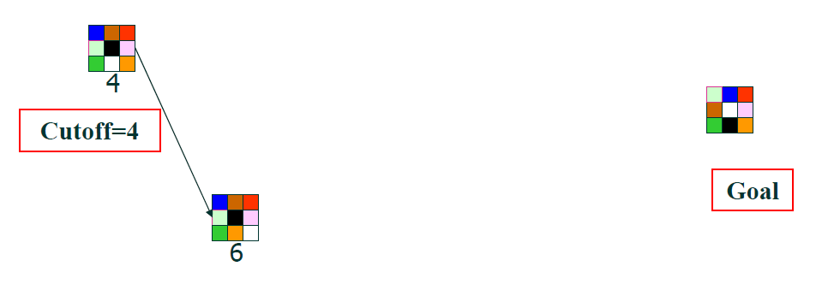
SEARCH
4
IDA*
Recursive version
IDA* is practical for many problems with unit step costs and avoids the substantial overhead associated with keeping a sorted queue of nodes.
Example
Recursive version: this implementation expands a node immediately if its f-cost does not exceed the cut-off value.
R
Successor generator sequence:
move the white tile right, up, left, down
Reference: Helmy, ICS-KFUPM

Slide 134
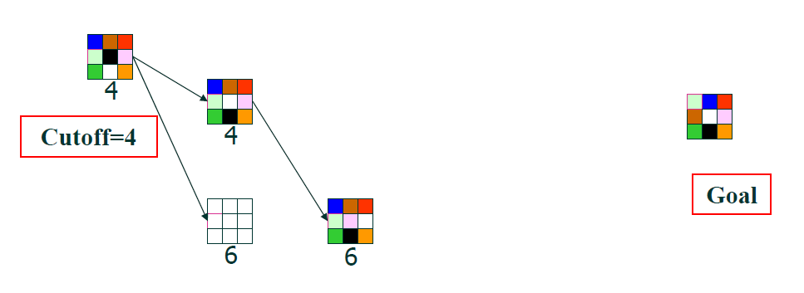
SEARCH
4
IDA*
Recursive version
U
R
R
Successor generator sequence:
move the white tile right, up, left, down

Slide 135
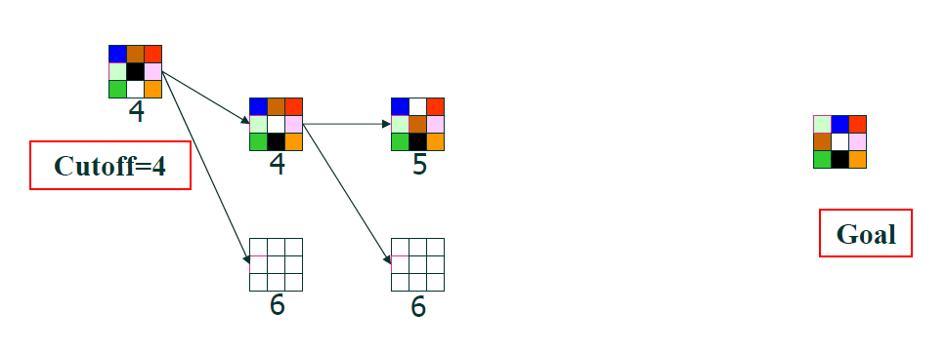
SEARCH
4
IDA*
Recursive version
U
U
R
R
Successor generator sequence:
move the white tile right, up, left, down

Slide 136
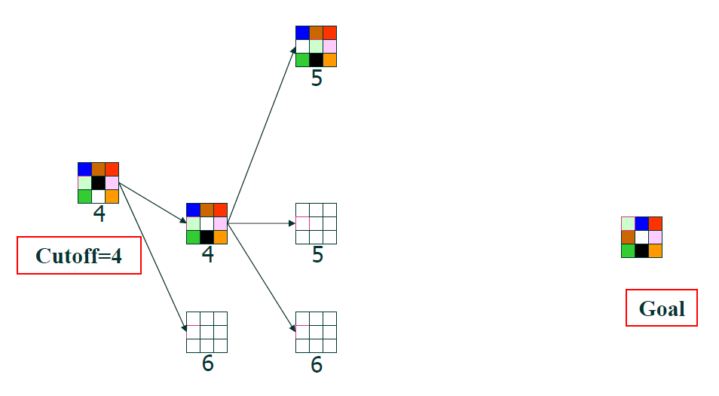
SEARCH
4
IDA*
Recursive version
L
U
U
R
R
Successor generator sequence:
move the white tile right, up, left, down

Slide 137
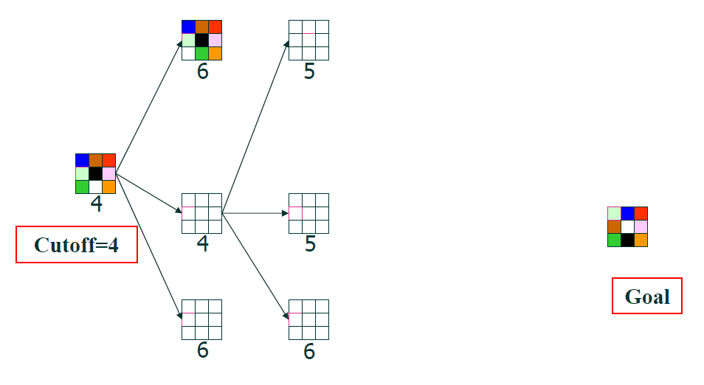
SEARCH
4
IDA*
Recursive version
At this stage, the Q is now empty and all the successor nodes generated has an f-cost that exceeds the cut-off; therefore, the algorithm restarts from the root node, but sets a new cut-off = minimum among the f-costs that exceeded the threshold.
L
L
U
U
New cut-off = min(5, 6) = 5
R
R
Successor generator sequence:
move the white tile right, up, left, down

Slide 138
SEARCH
4
IDA*
Recursive version
At this stage, the all successor nodes have been considered and all successor nodes generated have f-cost values that exceed the cut-off; therefore, the algorithm restarts at the root node, but sets a new cut-off = minimum among the f-costs that exceeded the threshold.
L
L
U
U
New cut-off = min(5, 6) = 5
R
R
Successor generator sequence:
move the white tile right, up, left, down

Slide 139
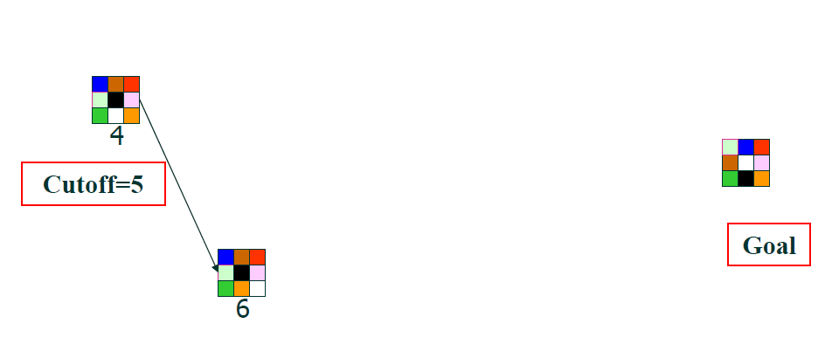
SEARCH
4
IDA*
Recursive version
With a new cut-off value of 5, we restart from the root node.
R
Successor generator sequence:
move the white tile right, up, left, down

Slide 140
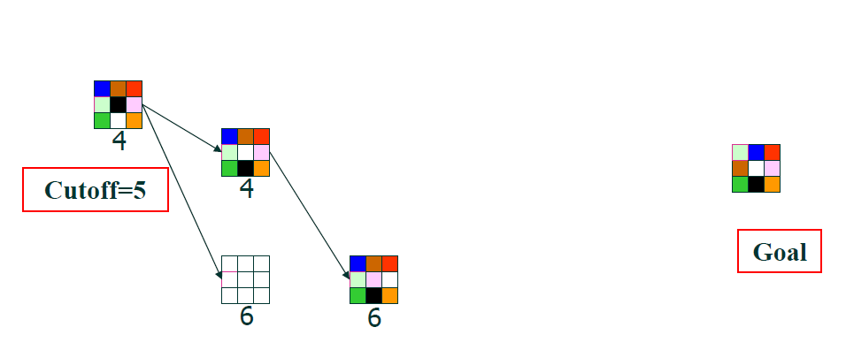
SEARCH
4
IDA*
Recursive version
U
R
R
Successor generator sequence:
move the white tile right, up, left, down

Slide 141
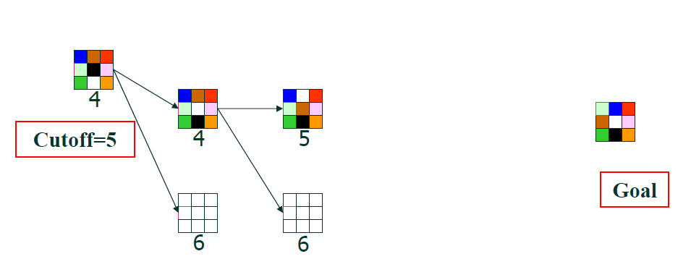
SEARCH
4
IDA*
Recursive version
U
U
R
R
Successor generator sequence:
move the white tile right, up, left, down

Slide 142
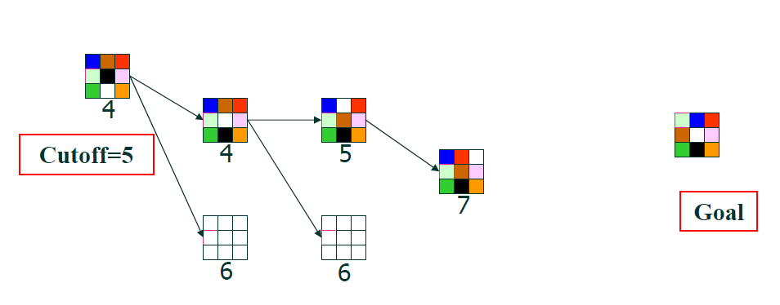
SEARCH
4
IDA*
Recursive version
U
U
R
R
R
Successor generator sequence:
move the white tile right, up, left, down

Slide 143
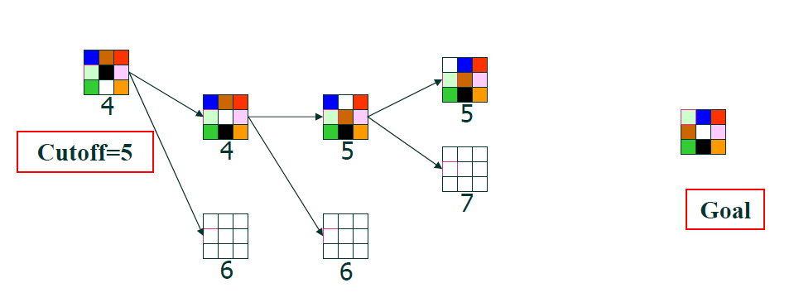
SEARCH
4
IDA*
Recursive version
It is not possible to move the white tile Up, so we move it to the Left next.
L
U
U
R
R
R
Successor generator sequence:
move the white tile right, up, left, down

Slide 144
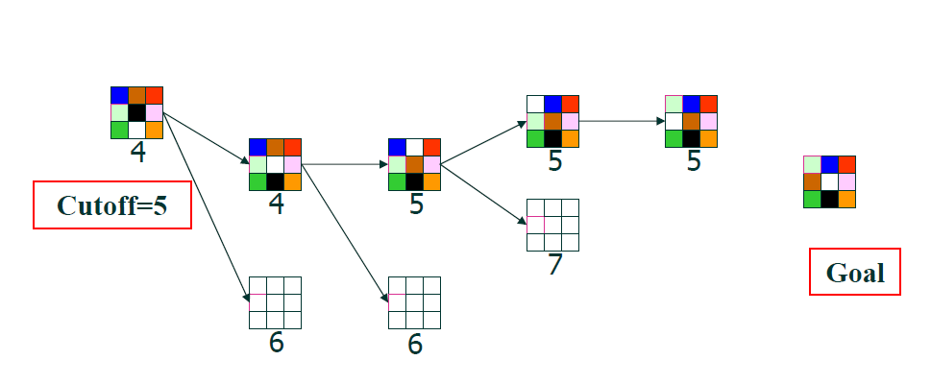
SEARCH
4
IDA*
Recursive version
This implementation avoids local loops, and so the move to the right was discarded.
D
Successor generator sequence:
move the white tile right, up, left, down

Slide 145
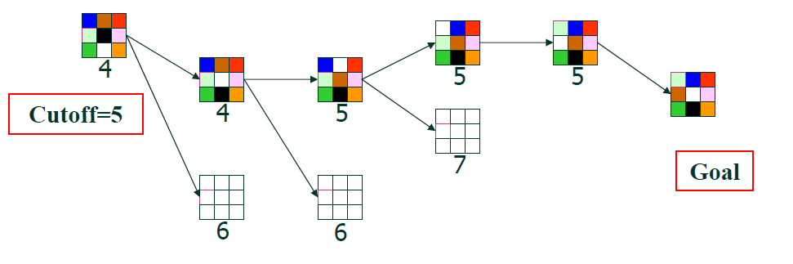
SEARCH
4
IDA*
Recursive version
R
A solution has been found!
Successor generator sequence:
move the white tile right, up, left, down

Slide 146
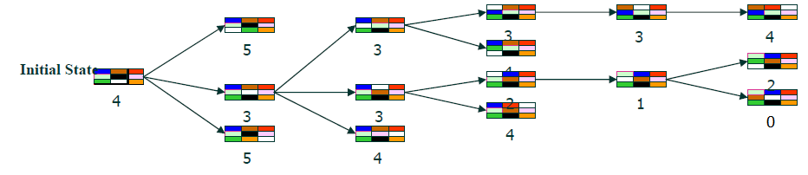
SEARCH
4
IDA* vs. A*
A*
heuristic
heuristic
heuristic
Goal
heuristic
IDA*
Successor generator sequence:
move the white tile right, up, left, down

Slide 147
SEARCH
IDA* vs. A*
IDA* is simpler to implement than A*. Does not require the Strict Expanded List.
IDA* expands the same number of nodes, asymptotically, as A* in an exponential tree search.
Since IDA* always expands all nodes at a given f-cost (minimum values which exceeded the previous cut-off) before expanding any nodes at a greater cost, the first solution it finds will be a solution of least cost.
For very large trees, A* will run out of memory space, but IDA* will still be able to solve them.
Notes:
C:\CORE\Massey_Papers_2016\159740-2016\Website\159740\Demo_2016\Search_2016_v12.7_fast_URDL_IDA
As the tree grows exponentially very large, eventually, IDA* approaches the same number of node expansions asymptotically as A* - meaning the number of node expansions produced by IDA* is greater than A*’s, but the difference becomes smaller and smaller as the problem grows exponentially.

Slide 148
SEARCH
IDA* vs. A*
Fifteen-Puzzle Problem
It was observed that even though IDA* generated more nodes than A*, it actually run faster than A* on solvable instances of the puzzle, due to less overhead per node.
- R.E.Korf, Depth-First Iterative Deepening: An Optimal Admissible Tree Search*
8-Puzzle Problem
Let us look at the demo and tabulated results to compare the two in terms of optimality, actual running time, MaxQLength, and number of state expansions.
Let us see some demos next…
Notes:
C:\CORE\Massey_Papers_2016\159740-2016\Website\159740\Demo_2016\Search_2016_v12.7_fast_URDL_IDA
As the tree grows exponentially very large, eventually, IDA* approaches the same number of node expansions asymptotically as A* - meaning the number of node expansions produced by IDA* is greater than A*’s, but the difference becomes smaller and smaller as the problem grows exponentially.

Slide 149
References:
MIT opencourseware – artificial intelligence
IDA* Example: Helmy, ICS-KFUPM
1985, Korf, Depth-First Iterative-Deepening: An Optimal Admissible Tree Search*
Russell and Norvig, Artificial Intelligence, Modern Approach 1st, 2nd, 3rd edition

Slide 150
(Optional) Non-Strict Expanded List
Store the g-cost as part of each state recorded

Slide 151
SEARCH
4
Dealing with inconsistent heuristic
Example:
We have a node we are considering adding into Q:
???
(6 CBS)
Q
Non-Strict Expanded List
(10 FEDS) …
4C
f-cost
A
…
1
g-cost
S
1
1
B
C
…
We can store either the g-cost or the f-cost to allow for the corrections to be made
2
Worst-case complexity

Slide 152
SEARCH
4
Dealing with inconsistent heuristic
Example:
We have a node we are considering adding into Q:
???
(6 CBS)
Q
Non-Strict Expanded List
(10 FEDS) …
4C
f-cost
A
…
1
g-cost
S
1
1
B
C
…
2
f-cost(CBS) = g(S-B-C) + h(C)
3 + 3 = 6
f-cost(CBAS) = g(S-A-B-C) + h(C)
Worst-case complexity
4 + 3 = 7

Slide 153
SEARCH
4
Dealing with inconsistent heuristic
Example:
We have a node we are considering adding into Q:
???
(6 CBS)
Q
Non-Strict Expanded List
(10 FEDS) …
4C
f-cost
A
…
1
g-cost
S
1
1
B
C
…
2
f-cost(CBS) = g(S-B-C) + h(C)
3 + 3 = 6
f-cost(CBAS) = g(S-A-B-C) + h(C)
Worst-case complexity
4 + 3 = 7

Slide 154
SEARCH
4
Dealing with inconsistent heuristic
Example:
We have a node we are considering adding into Q:
???
(6 CBS)
Q
Non-Strict Expanded List
(10 FEDS) …
4C
A
…
3 < 4, and so we should add (6 CBS) into the Q, then delete 4C from the Non-Strict Expanded list
1
S
1
1
B
C
…
2
f-cost(CBS) = g(S-B-C) + h(C)
3 + 3 = 6
f-cost(CBAS) = g(S-A-B-C) + h(C)
Worst-case complexity
4 + 3 = 7

